Slide 1



SUSTAINABLE E-COMMERCE PACKAGING AND INVENTORY MANAGEMENT SYSTEM
DSA0101 - OBJECT ORIENTED PROGRAMMING WITH C++
BY:
NEHLA FATHIMA A RISHITHA S
[1971260019] [1971260015
GUIDED BY:
Dr. PARIMALA KANAGA DEVAN K
SANDHYARANI SETHI [1911260076]

Slide 2
ABSTRACT
TheSus tainableE-Commerce Packaging Inventory Management System is a C++
based application designed to efficiently manage packaging materials used in e-
commerce operations. The system focuses on reducing packaging waste, avoiding
stock shortages and improving the selection of suitable packaging. It consists of
three major modules: Inventory Tracking, Smart Package Selection and Supplier
Reorder. Object-oriented programming concepts such as classes, objects,
encapsulation, constructors and member functions are used to develop the system.
By combining inventory monitoring with appropriate package selection and timely
supplier reordering, the system supports efficient and sustainable packaging
management.

Slide 3

INTRODUCTION
E-commerce uses large amounts of packaging materials.
Poor packaging management can cause waste and extra cost.
Proper inventory tracking prevents stock shortages.
Smart package selection reduces unnecessary material use.
Supplier reordering ensures packaging availability.

Slide 4
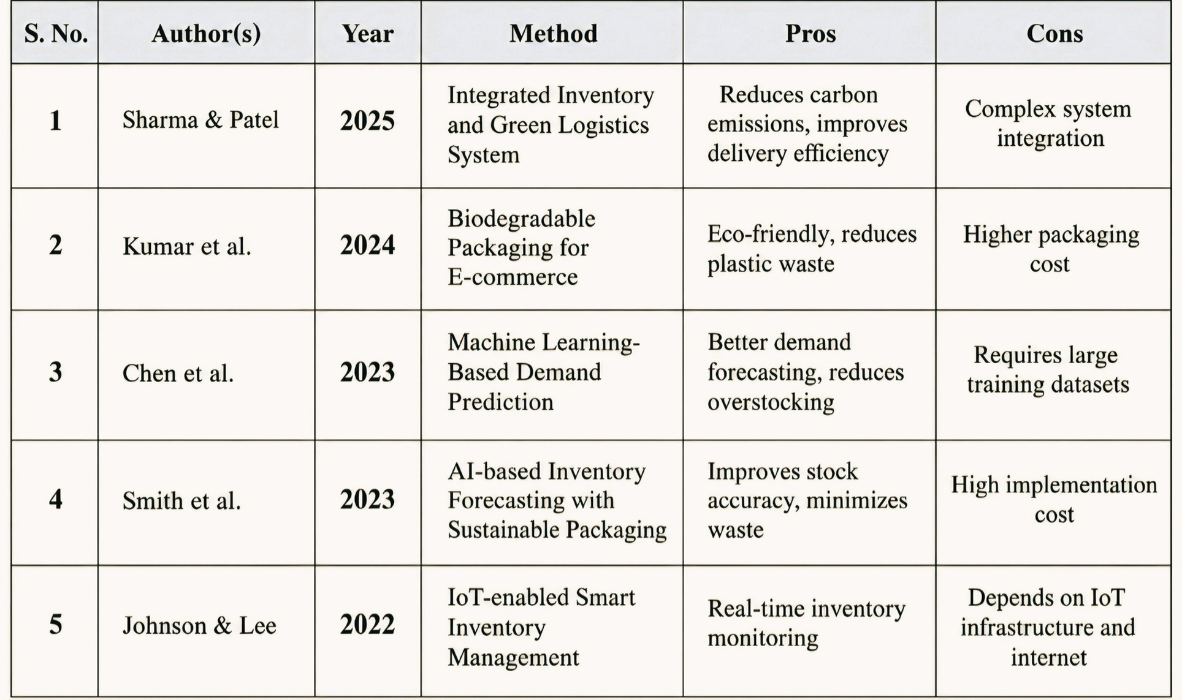
LITERATURE SURVEY

Slide 5


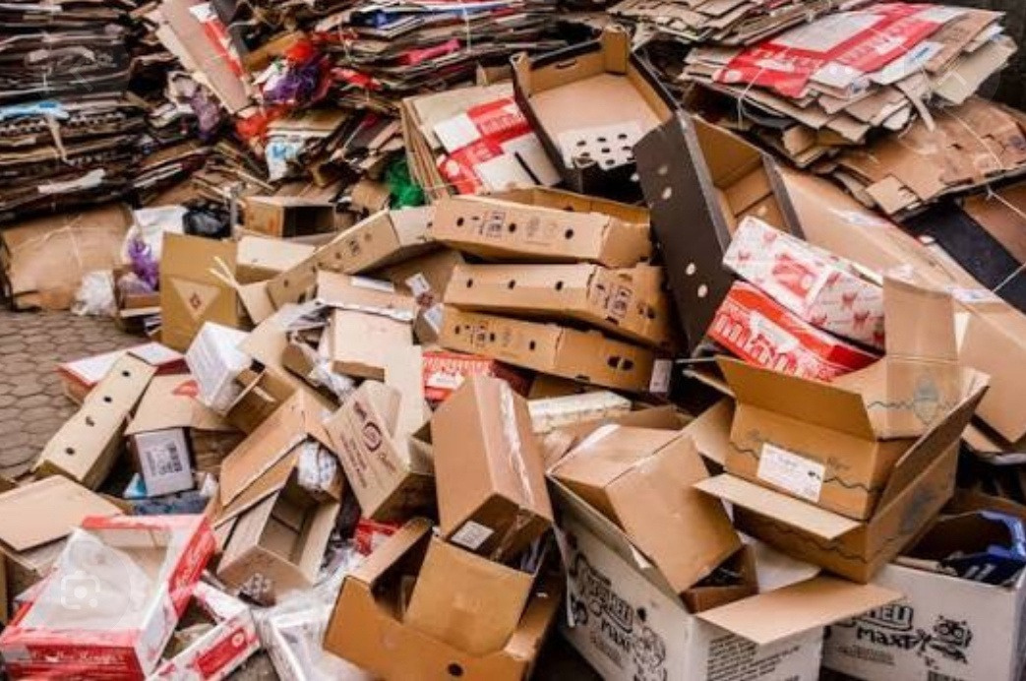



PROBLEM STATEMENT
1
Difficult to identify low-stock materials.
2
Use of unnecessarily large boxes.
3
Delayed supplier reordering.
Higher cost + Material wastage + Inventory problems

Slide 6


OUR SOLUTION
01
Low-stock alerts help identify
materials that need replenishment.
02
Smartpackage selection helps choosethe appropriate package size and reduce waste.
03
Thesystem suggests reordering
when the stock reaches the minimum level.

Slide 7
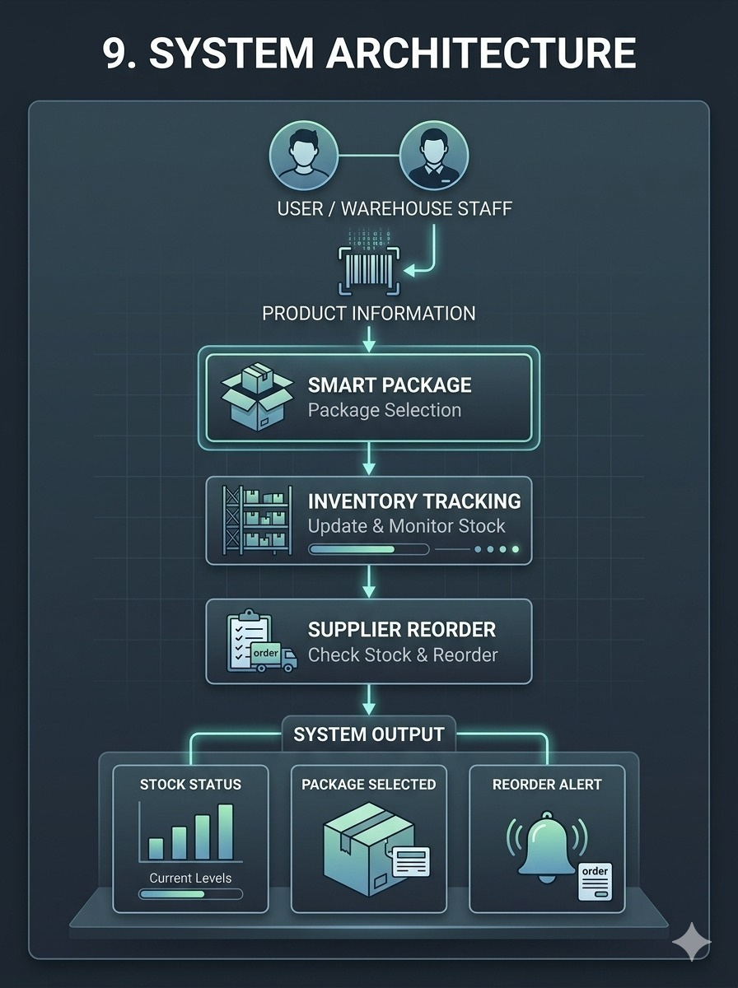
SYSTEM
ARCHITECTURE
1. InventoryTracking:
Tracks packaging materials and available quantities.
2. Smart Package:
Selects the smallest suitable package for a product.
3. Supplier Reorder:
Detects low stock and calculates the required reorder quantity.

Slide 8


MODULE -1
Inventory Tracking
Purpose
The Inventory Tracking Module helps monitor the quantity of packaging materials available in stock.
Main Functions
Stores package details such as ID, name and quantity.
Displays the current stock level.
Checks whether the stock is sufficient.
Gives a low-stock alert when quantity falls below the minimum level.
Helps
prevent
both
stock
shortages
and
Class → Object → Constructor → Member Function
unnecessary overstocking.

Slide 9
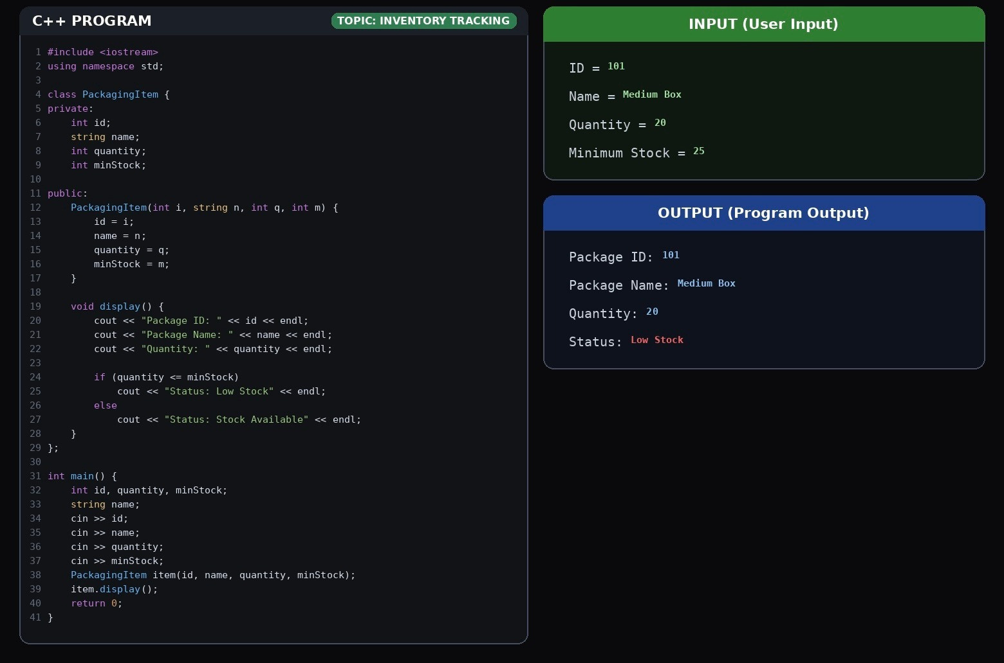

Slide 10

MODULE -2
Smart Package
Purpose
The Smart Package Module selects a suitable package based on the product dimensions.
Main Functions
Takes product length, width and height as input.
Compares the product size with available packages.
Selects the smallest suitable package. Helps reduce unnecessary packaging material.
Supports sustainable packaging.
Class → Object → Constructor → Member Function

Slide 11
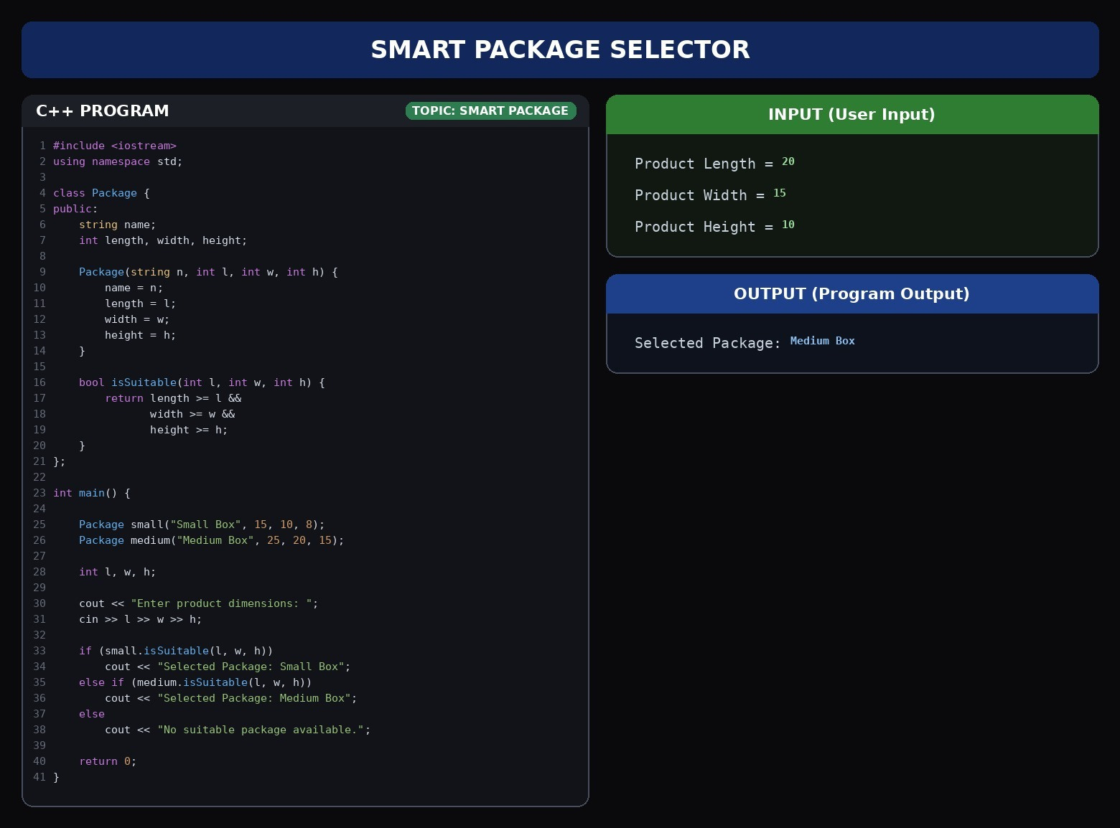

Slide 12

MODULE -3
Purpose
The Supplier Reorder Module checks the packaging stock and suggests reordering when the quantity becomes low.
Supplier Reorder
Main Functions
Checks the current stock level. Compares stock with the minimum required level.
Identifies when a reorder is needed. Calculates the required reorder quantity. Displays the supplier details.
Class → Object → Constructor → Member Function

Slide 13
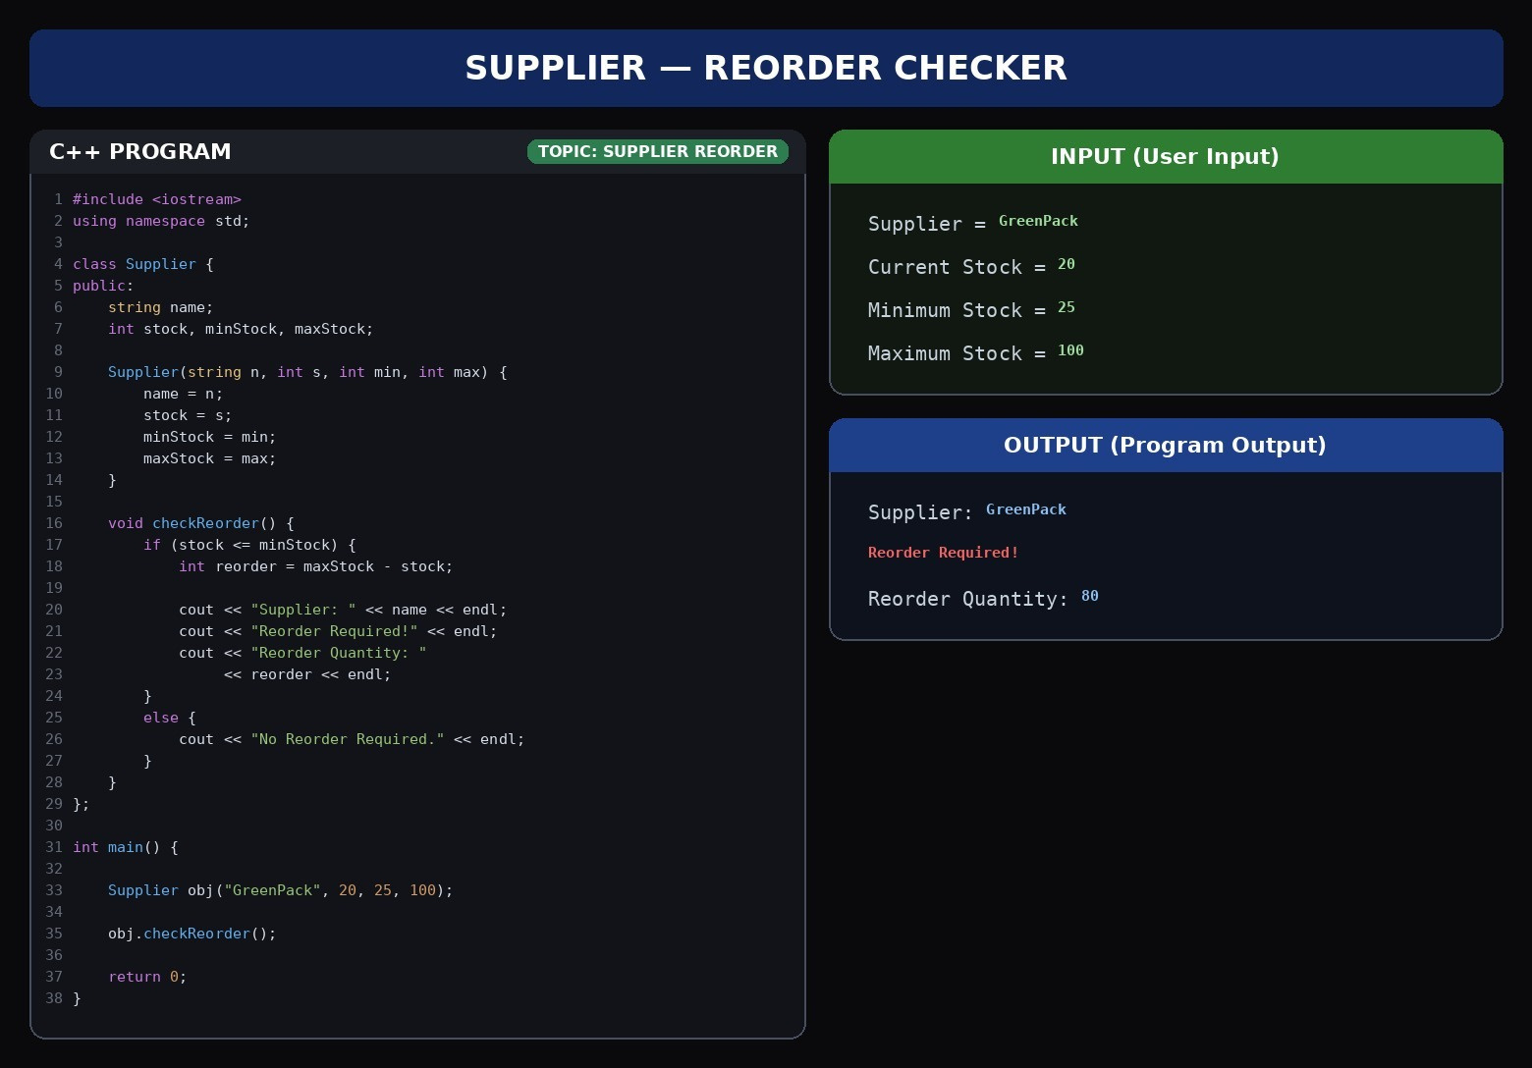

Slide 14
TECHNOLOGIES AND CONCEPTS
TECHNOLOGY:
Programming Language: C++
Programming Paradigm: Object-Oriented Programming (OOP)
Interface Type: Console/menu-driven application (typical for such C++ OOP projects)
OOP CONCEPTS:
Classes – Blueprints for Inventory items, Packages, and Suppliers.
Objects – Real instances representing actual stock items, package options, and supplier records. Encapsulation – Groups data (quantity, dimensions, supplier details) with related functions, protecting internal details.
Constructors – Auto-initialize object data when items/packages/suppliers are created.
Member Functions – Perform core logic: checking stock, comparing dimensions, calculating reorder quantity.

Slide 15



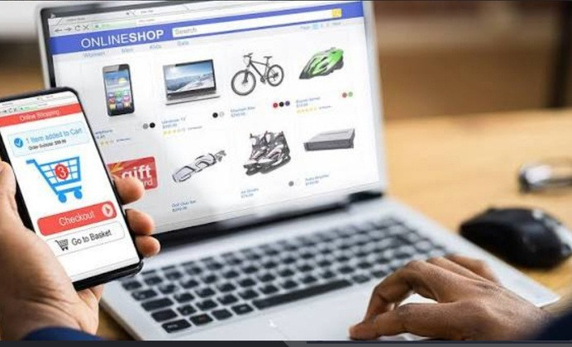
ADVANTAGES
Environmental
Reduces packagingw aste.
Encourages appropriate package sizes.
Supports sustainable materials.
Operational
Easy inventory monitoring. Quick identification of low stock.
Timely supplier reordering.
Technical
Simple OOP-based structure. Modular design.
Easy to modify and extend.
Classes can be reused for additional features.

Slide 16

CONCLUSION
The system helps manage e-commerce packaging efficiently.
Smart Package selects a suitable package size. Supplier Reorder helps maintain sufficient stock.
It reduces unnecessary packaging and material waste. Overall, the system supports efficient and sustainable e-commerce packaging management.

Slide 17

REFERENCES
•1. J. Park, A.Waqar, andL.V. Snyder,"Environmental Analysis of Returnable Packaging Systems in
Different E-Commerce Business and Packaging Management Models," Journal of Industrial Ecology, vol. 28, no. 2, pp. 345–361, 2024.
•2. B. Frommeyer et al., "Recycled or Reusable: A Multi-Method Assessment of Eco-Friendly Packaging in Online Retail," Journal of Industrial Ecology, vol. 28, no. 1, pp. 112–129, 2024.
Transportation Review, vol. 186, Ar t. no. 103512, 2024.
•3. J. Clement and S. Spinler, "Advancing SustainabilityinE-CommercePackaging:ASimulation-Based Study for Managing Returnable TransportItems,"TransportationResearchPartE:Logisticsand
•4. B. Stroustrup, Programming: Principles and Practice Using C++, 2nd ed. Boston, MA, USA: ddison- Wesley, 2020.
•5. E. Balagurusamy, Object-Oriented Programming with C++, 8th ed. New Delhi, India: McGraw-Hill Education, 2020.

Slide 18
GITHUB PROFILE
https://github.com/rishithashetty008

Slide 19
TH
ANK YOU

